Slide 1
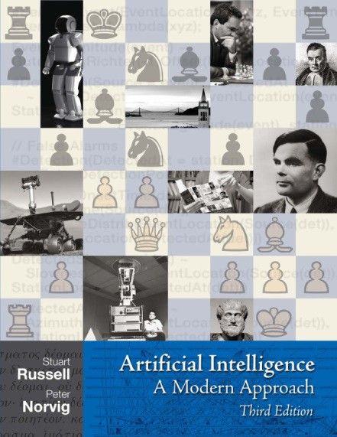
CS7050 Artificial Intelligence
Course text:
“Artificial Intelligence: A modern approach” by Russell & Norvig
Fourth edition ISBN 0132071487, Pearson Education
Assessment: 50% coursework
Implement AI for a puzzle or a game
Write a report
Released in Week 3
Must be submitted by the end of Week 11 (08/12/2023 Before Christmas)
12 Sessions (lecture(2h) + workshop(2h)),
Introduction to AI [1]
Problem solving and search [2]
Informed search and heuristics [1]
Playing games [1]
Knowledge representation [1]
Classical planning [1]
Navigating robots [1]
Constraint satisfaction problems [1]
Reinforcement learning [2]
Ethical, Legal and Philosophical issues of AI [1]
50% written exam
held between 15 January and 28 January 2024
How not to fail the module:
Finish at home all programming assignments, even if it takes a lot of your spare time
Read the textbook
Solve theoretical problems on your own before we discuss them in class

Slide 2
Artificial Intelligence
Chapter 1

Slide 3
Outline
What is AI?
A brief history
The state of the art

Slide 4
What is AI?
Systems that think like humans | Systems that think rationally
Systems that act like humans | Systems that act rationally

Slide 5




Acting humanly: The Turing test
Turing (1950) “Computing machinery and intelligence”:
“Can machines think?” vs. “Can machines behave intelligently?”
Operational test for intelligent behavior: the Imitation Game
HUMAN
HUMAN INTERROGATOR
?
AI SYSTEM
Behaviourist paradigm of considering the intelligence

Slide 6
Alan Turing (1950): "I believe that at the end of the century the use of words and general educated opinion will have altered so much that one will be able to speak of machines thinking without expecting to be contradicted"
Predicted that by 2000, a machine might have a 30% chance of fooling a lay person for 5 minutes
Anticipated all major arguments against AI in following 50 years
Suggested major components of AI: knowledge, reasoning, language understanding, learning

Slide 7
John Searle (The Chinese Room argument, 1980): Even that from the point of view of the interrogator the man in the room understand Chinese, it might be the case that from his own point of view he doesn’t, so the Turing Test failed to prove the ability of machines to think like humans…
Problem with the Turing Test:
Not reproducible (different people, different languages, different reactions)
Not constructive (black box approach, does not explain the mechanisms of intelligent behaviour)
Not amenable to mathematical analysis

Slide 8
Thinking humanly: Cognitive Science
1960s “cognitive revolution”: information-processing psychology replaced prevailing orthodoxy of behaviorism
Requires scientific theories of internal activities of the brain
What level of abstraction? “Knowledge” or “circuits”?
How to validate? Requires
Predicting and testing behavior of human subjects (top-down) or 2) Direct identification from neurological data (bottom-up)
Both approaches (roughly, Cognitive Science and Cognitive Neuroscience) are now distinct from AI
Both share with AI the following characteristic:
the available theories do not explain (or engender) anything resembling human-level general intelligence
Hence, all three fields share one principal direction!

Slide 9
Thinking rationally: Laws of Thought
Normative (or prescriptive) vs. logical (or descriptive)
Aristotle: what are correct arguments/thought processes?
Several Greek schools developed various forms of logic as notation for describing the facts about the world and our knowledge, and rules of inference for our thoughts;
may or may not have proceeded to the idea of mechanization
Direct line through mathematics and philosophy to modern AI
Problems:
Not all intelligent behavior is mediated by logical deliberation
What is the purpose of thinking? What thoughts should I have out of all the thoughts (logical or otherwise) that I could have?

Slide 10
Acting rationally: Ability to change the environment
Rational behavior: doing the right thing
The right thing: that which is expected to maximize goal achievement, given the available information
Doesn’t necessarily involve thinking—e.g., blinking reflex—but thinking should be in the service of rational action
Logical thinking: able to explain the reason
Based on a reason:
Aristotle (Nicomachean Ethics): Every art and every inquiry, and similarly every action and pursuit, is thought to aim at some good
Doesn’t necessarily involve acting upon the environment – it can be a computer program with simple keyboard input and display output (anthropomorphic intelligence vs. computer intelligence)
Doesn’t even need learning – it can use pre-programmed logical rules of inference (AI vs. ML)

Slide 11
AI: Rational agents
An agent is an entity that perceives and acts
This course is about designing rational agents
Abstractly, an agent is a function from percept histories to actions:
f : P∗ → A
For any given class of environments and tasks, we seek the agent (or class of agents) with the best performance
Caveat: computational limitations make perfect rationality unachievable
→ design best program for given machine resources

Slide 12
AI prehistory
Philosophy
Logic and ontolgy, methods of reasoning, mind as physical system
foundations of learning, language and rationality
formal representation and proof
algorithms and computation
phenomena of perception and motor control experimental techniques (psychophysics, etc.)
formal theory of rational decisions, games and negotiations
representation, parsing and understanding
plastic physical substrate for mental activity (brain and neurons
Mathematics
Psychology
Economics
Linguistics
Neuroscience
Control theory homeostatic systems, stability
simple optimal agent designs, adaptation

Slide 13
Potted history of AI
1943
1950
McCulloch & Pitts: Boolean circuit model of brain Turing’s “Computing Machinery and Intelligence”
1952–69 Look, Ma, no hands!
1950s
Early AI programs, including Samuel’s checkers program, Newell & Simon’s Logic Theorist, Gelernter’s Geometry Engine Dartmouth meeting: “Artificial Intelligence” adopted Robinson’s complete algorithm for logical reasoning
1956
1965
1966–74 AI discovers computational complexity Neural network research almost disappears
1969–79 Early development of knowledge-based systems 1980–88 Expert systems industry booms
1988–93 Expert systems industry busts: “AI Winter” 1985–95 Neural networks return to popularity
1988–
Resurgence of probability; general increase in technical depth “Nouvelle AI”: ALife, GAs, soft computing
Agents, agents, everywhere . . .
Semantic Web
Human-level AI back on the agenda
1995–
1999–
2003–

Slide 14
Some Key Milestones of AI
The Logic Theorist (1950s,1960s)
Succeeded in proving theorems from a maths book
it mimicked the work of a mathematician
produced shorter proofs than those in the book.
Astonishing to see a computer doing something clever!
At a time where computers could do little more than sums
Proving theorems requires knowledge and creativity
Understanding the rules of “right thinking”
Applying such rules in a suitable way

Slide 15
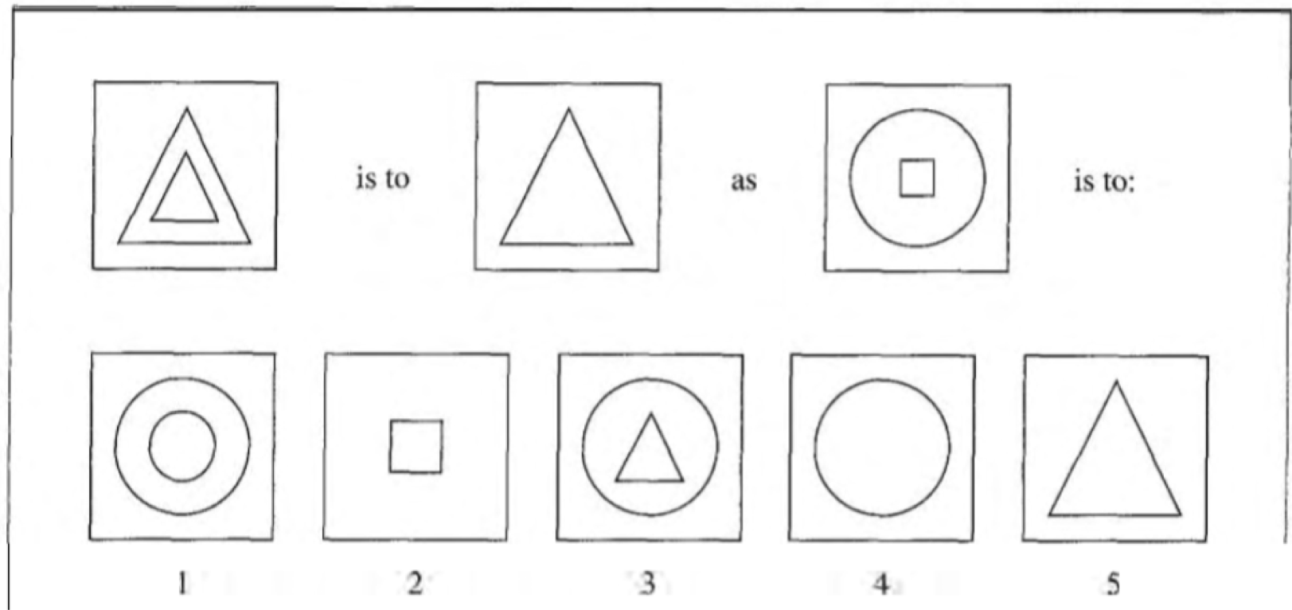
Some Key Milestones of AI
Sophisticated follow-up systems (1960s-1970s):
SAINT (1963)
Solve university-level calculus problems
ANALOGY (1968)
Solve geometrical analogy problems from IQ tests

Slide 16
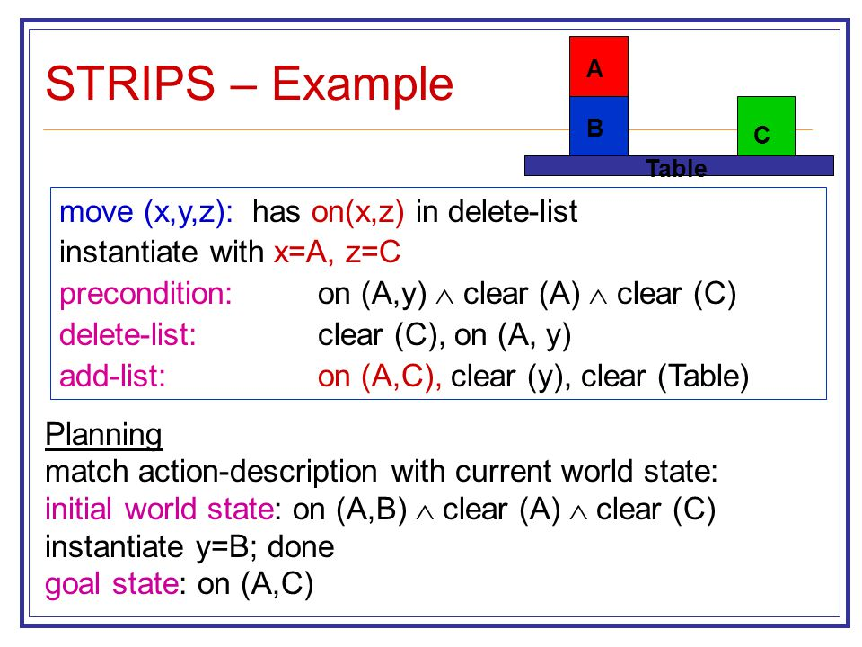
Some Key Milestones of AI
STRIPS (Stanford Research Institute Problem Solver, 1971

Slide 17

Some Key Milestones of AI
MYCIN (1970s)
System for medical diagnosis
Focused on blood infections
Was able to perform as well as some medical experts And far better than junior doctors!

Slide 18
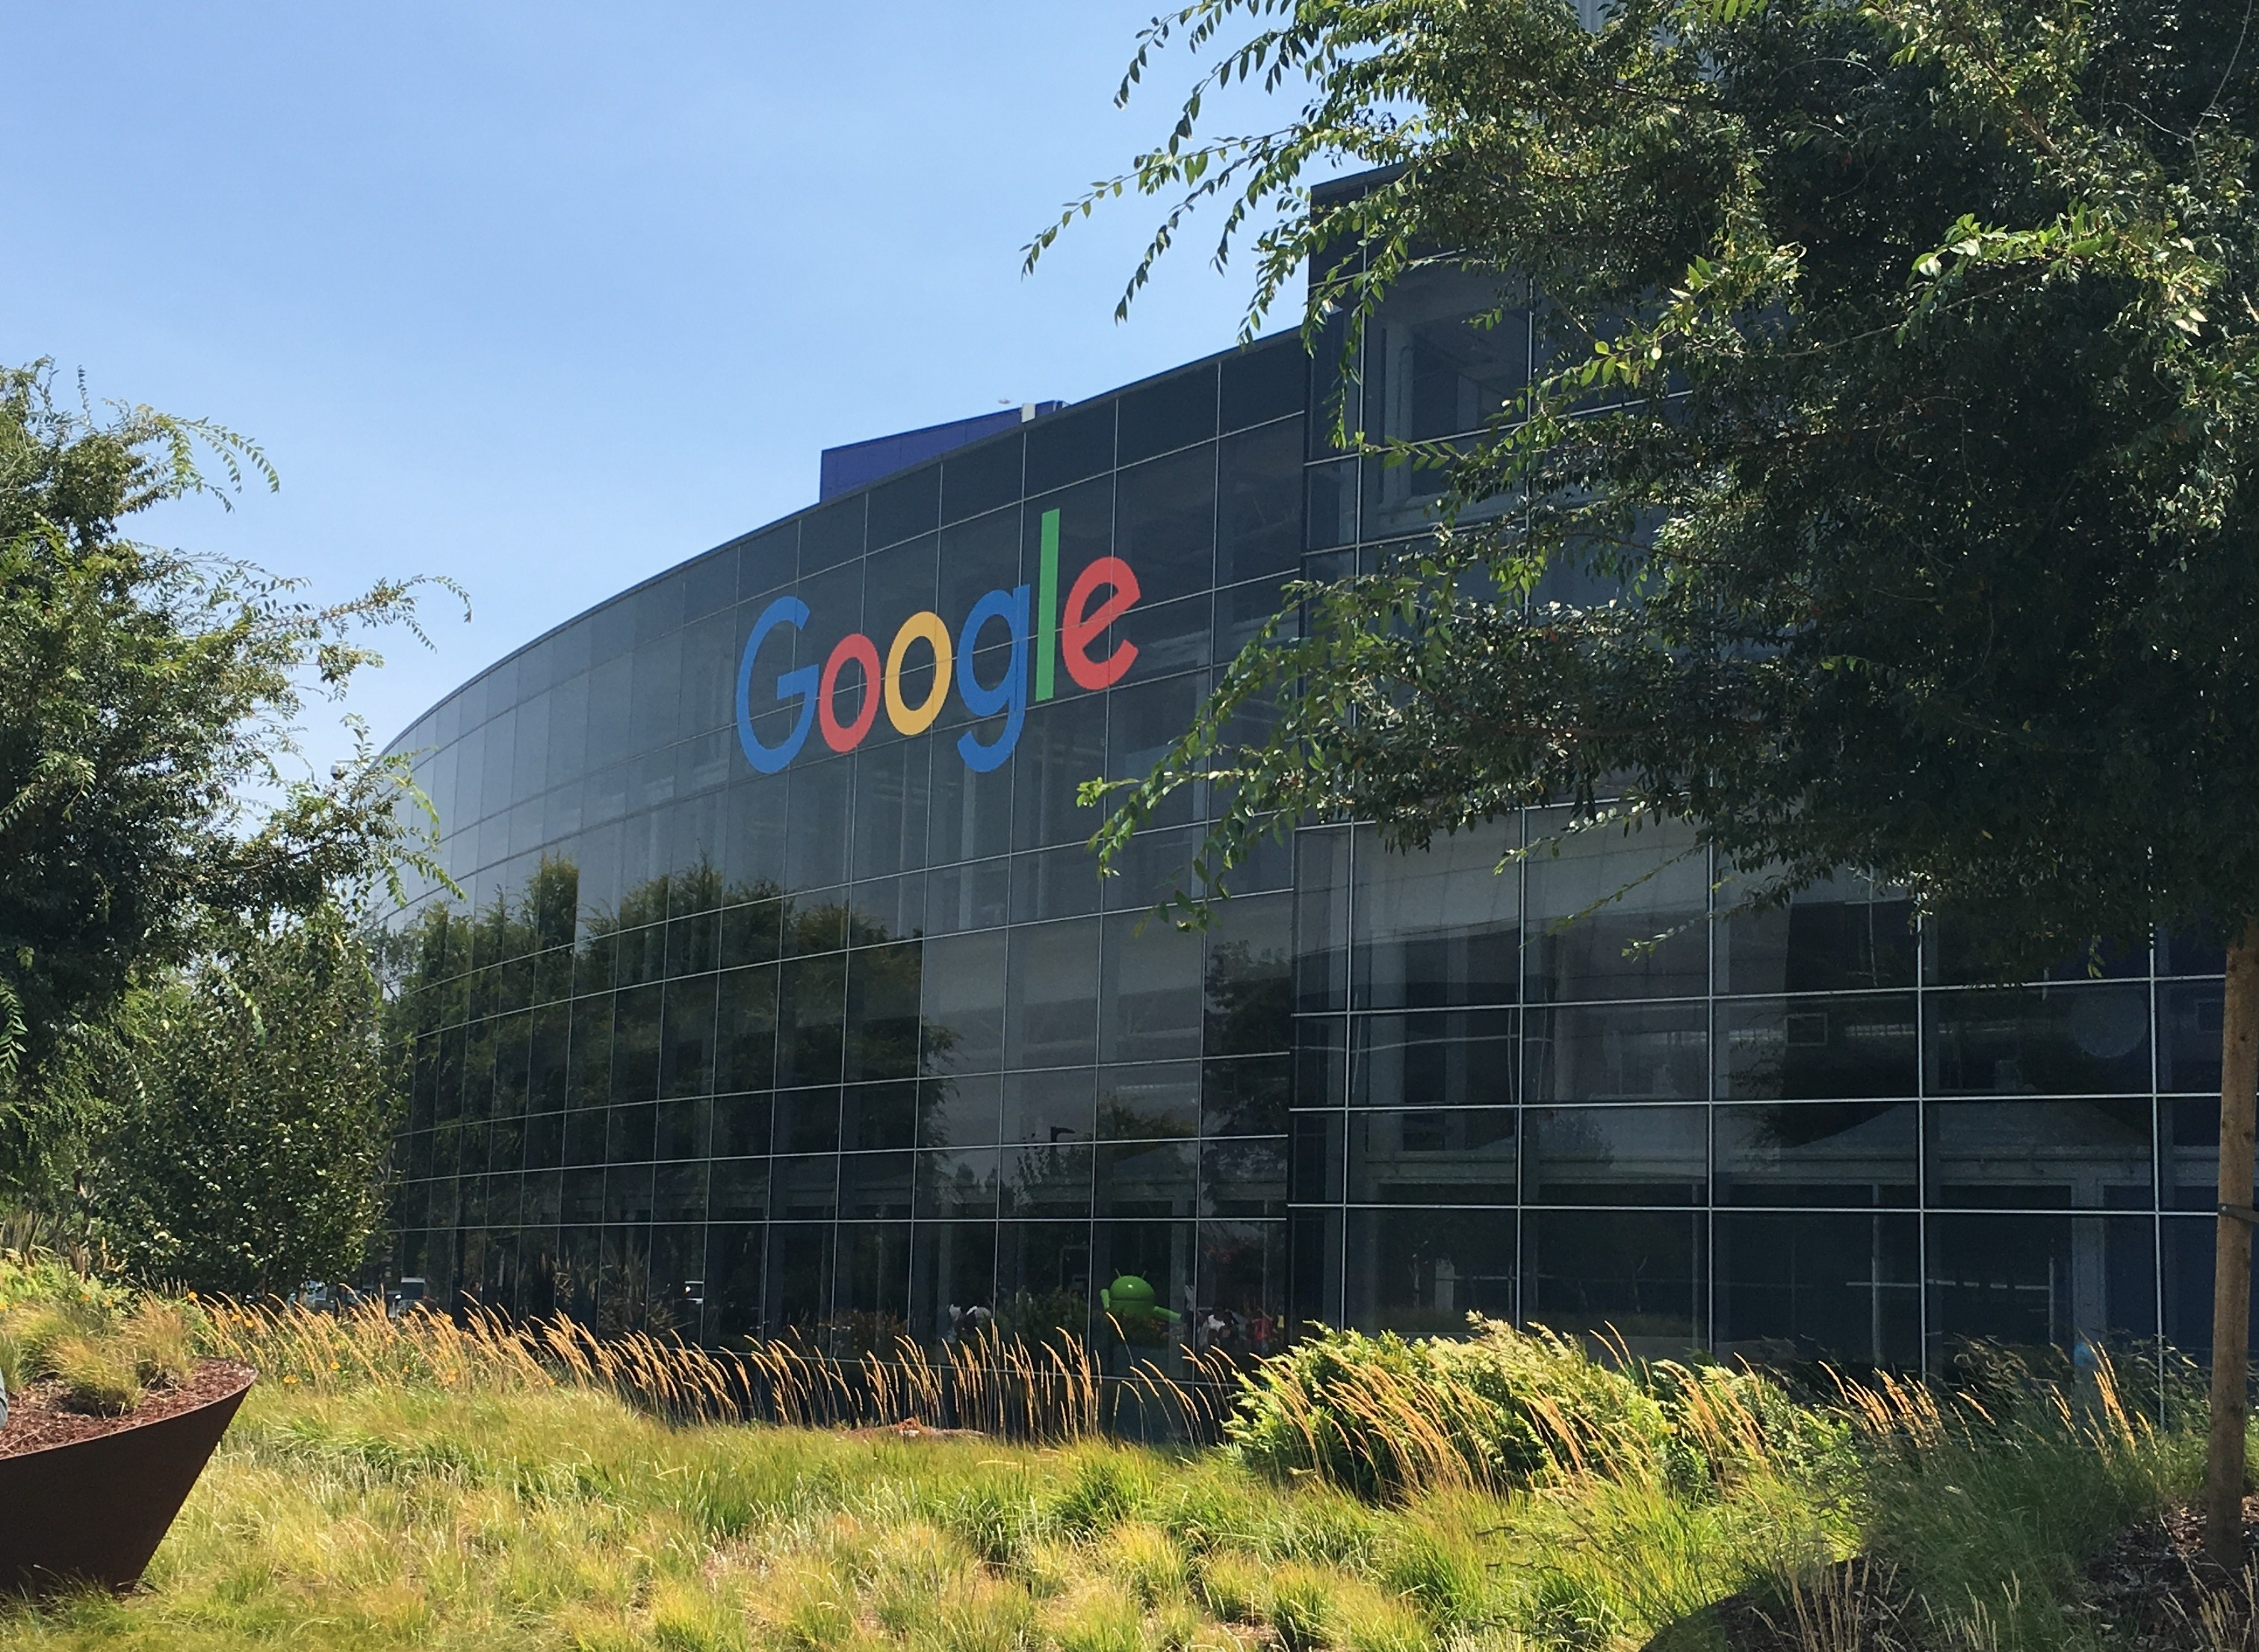
Some Key Milestones of AI
Larry Page and Sergey Brin found Google (1998)

Slide 19
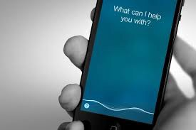
Some Key Milestones of AI
Siri (2011): iPhone 4S
Personal assistant in your mobile phone

Slide 20
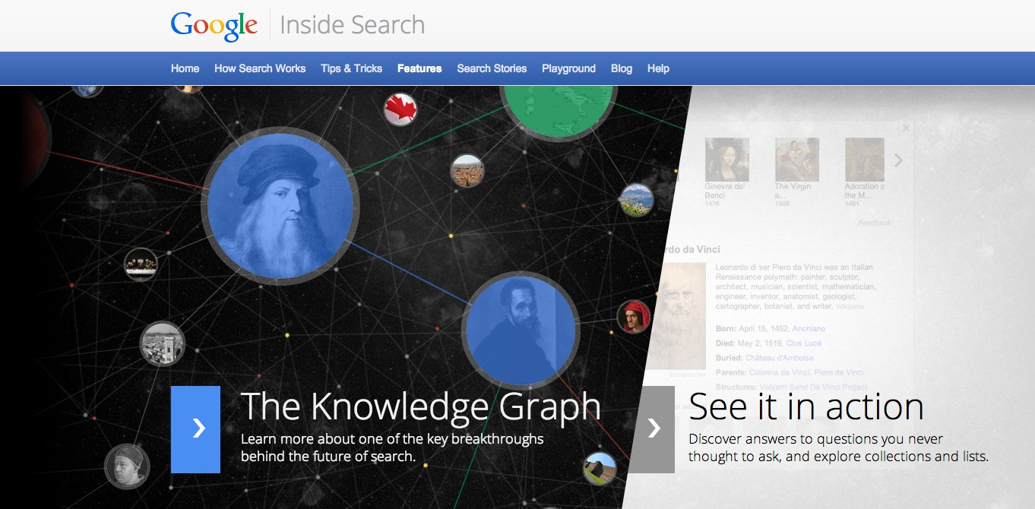
Some key milestones of AI
Intelligent search and intelligent information systems (2010s)
Understanding large amounts of data
What I do…

Slide 21
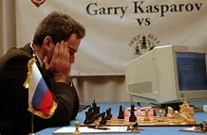
Some key milestones in AI
IBM Deep blue (1990s)
Beating Kasparov at chess in 1997

Slide 22
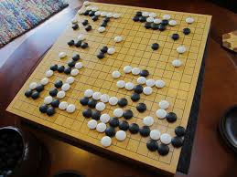
Some key milestones of AI
AlphaGO (2015)
Beating human players at GO

Slide 23
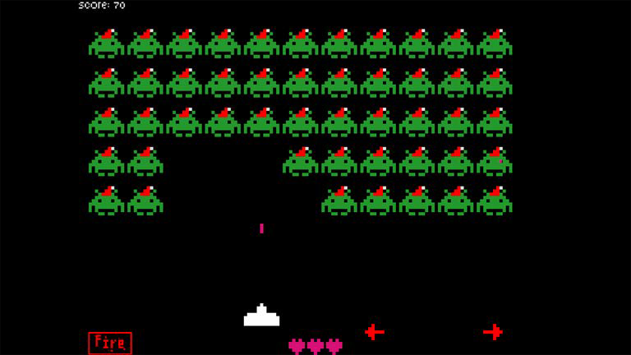
Some Key Milestones of AI
DeepMind and vintage game playing
A machine that learns to play a wide range of games

Slide 24
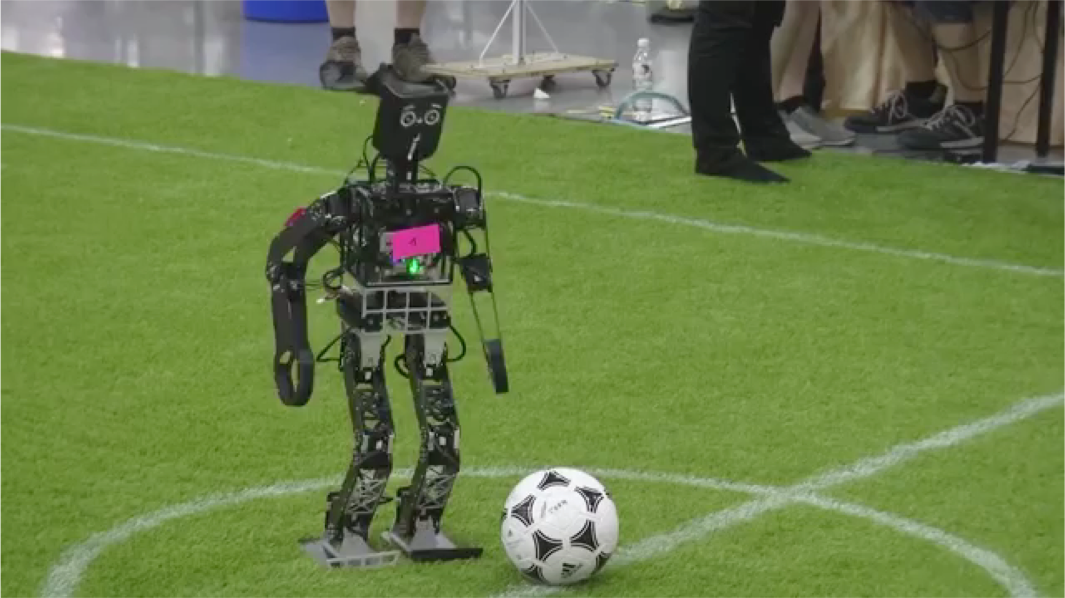
Some Key Milestones of AI
Robots playing football

Slide 25
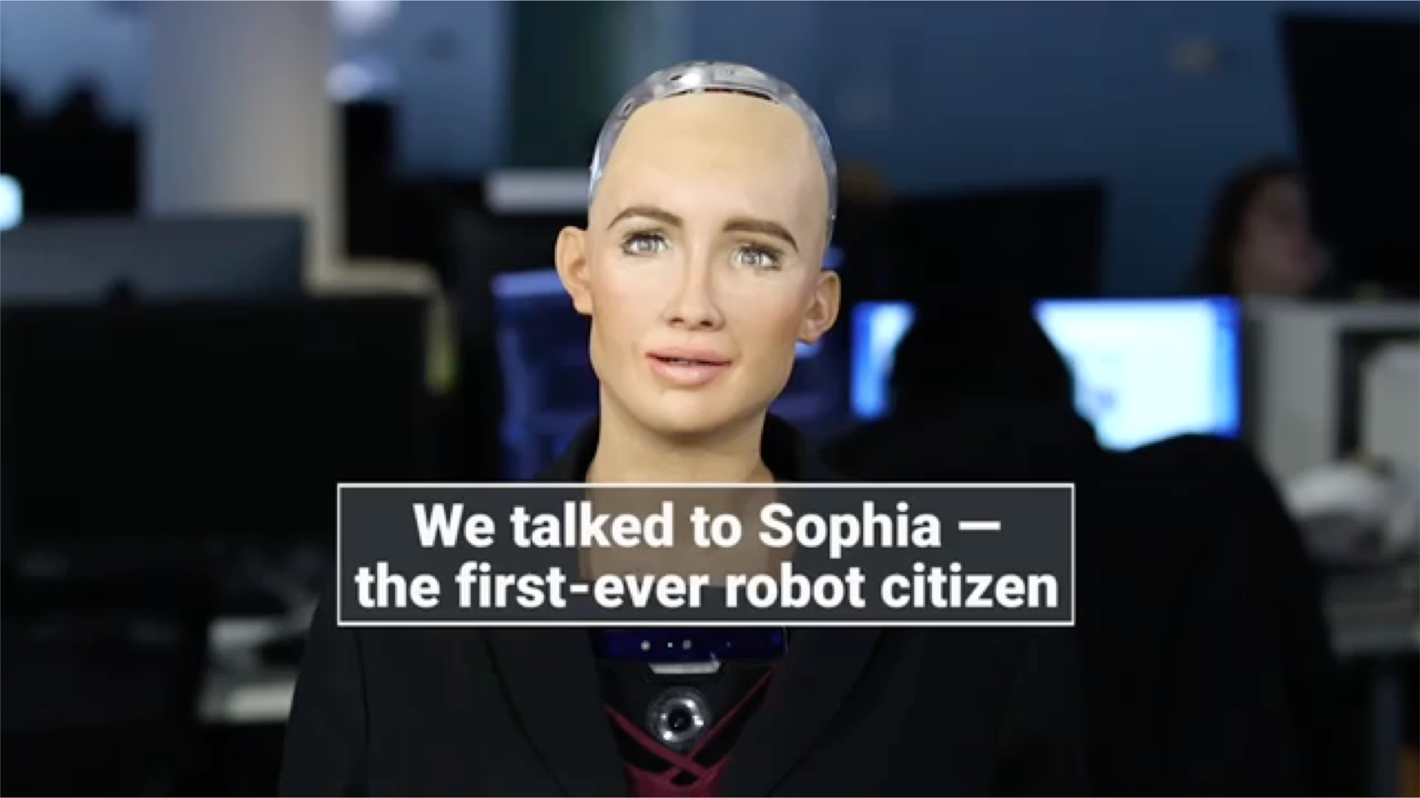
Some Key Milestones of AI
https://www.youtube.com/watch?v=S5t6K9iwcdw

Slide 26
Attitude Towards AI
AI never left scientists and the public indifferent
Enthusiasm
Amazement
Tremendous expectations
Fear
Skepticism
Disappointment

Slide 27
Early Successes and Expectations
A lot of excitement around early successes of AI
“A physical symbol system has the necessary and sufficient means for general intelligent action”
Herbert Simon [1957]
“It is not my aim to surprise or shock you, but the simplest way I can summarise it is to say that there are now in the world machines that think, that learn and that create. Moreover, their ability to do these things is going to increase rapidly until, in a visible future, the range of problems they can handle will be coextensive with the range to which the human mind has been applied”

Slide 28
Existential Risk and Fear
“Intelligent machines are quite possibly the most important and most daunting challenge humanity has ever faced.”
Nick Bostrom
“Artificial Intelligence could spell the end of Human Race “
Stephen Hawking
“AI is potentially more dangerous than nuclear weapons”
Elon Musk
“I don’t understand why some people are not concerned about AI”
Bill Gates
“Worrying about AI’ is like worrying about overpopulation in Mars
Andrew Ng.

Slide 29
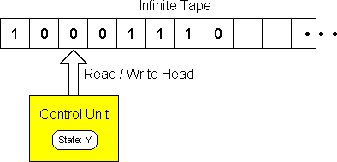
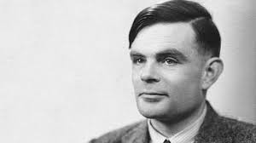
A First Reality Check
What computers can do known to be limited (since Turing) AI systems are subject to these fundamental limits

Slide 30
Limits of Computation
Roughly speaking, computational problems divided into
Easy
Can be solved efficiently for very large inputs
Hard
Performance not robust as input size increases
Unsolvable
No algorithm exists
Typical AI problems are either hard or unsolvable.

Slide 31
Examples in AI
Unsolvable problems
Proving general theorems
General reasoning with knowledge Quite a few more…
Hard problems
Playing games
Constraint satisfaction (e.g., crossword puzzles)
Classical planning (e.g., trip planning) Many,many more!
Easy problems
Almost none !

Slide 32
Second Reality Check
Developing AI requires enormous effort
Take MYCIN (medical diagnosis)
The system required knowledge about blood infections
Acquired through extensive expert interviews
Not really scalable
Take Watson (playing jeopardy)
Required a whole team
30+ people
Working full time for 4 years.

Slide 33
Third Reality Check
AI systems are too specific (“narrow AI”)
They do amazing, but very concrete things. Deep blue only knew how to play chess! Not adaptable, even for simpler games
Not easy to adapt to other problems.
Very brittle
Quest for “general intelligence”

Slide 34
Fourth Reality Check
Lack of true breakthroughs
Fundamental techniques have not changed since 1990s
They are better understood scientifically
They have been refined and improved
Two major changes since the early days
Massive increase in computing power
Availability of data
Mathematical tools for analysis
AI is now a science rather than just an art.

Slide 35
What will the Future Bring Us?
Reshaping Businesses
Reshaping the Job Market
Reshaping Society
37

Slide 36

Traditional Banking
Many branches
Cashiers
Mortgage Advisors
Loan Approval Departments
Thousands of employees
….

Slide 37

FinTech: WeBank
No branches or direct salesforce.
Bots handle 98% of customer service enquiries using AI
Robots collect applicant data and run credit checks
Facial recognition for identity identification
Ability to get a loan in 30 seconds 24/7
Micro loans (1200$ on average) in 5s.
More than 100 million active customers
Total net profit of $359 million

Slide 38
FinTech: Major Challenges
Safety
Adversarial learning, fooling models through malicious input
Fairness
Difficult to explain why a ML algorithm decided not to give me credit
Data Protection
Meeting regulations, avoiding discrimination.

Slide 39
Jobs for Everyone?
When you grow up you may not have a job
Two different views amongst experts:
Within 20-30 years billions of people will become economically redundant
Even in the long run, technology will create more jobs than it destroys.
Fear of massive unemployment and irrelevance.
54

Slide 40
The AI Dilemma
Pure Logic
Top-down approach to AI
Humans provide machine-readable knowledge
Requires human understanding of the problem
Knowledge + Data = Intelligent Behaviour
Algorithms are domain-independent
Pure Learning
Bottom-up approach to AI
Find patterns in the data
Requires little understanding of the problem
Requires a lot of data

Slide 41
Limitations
Logic-based approaches
Generating knowledge
Reasoning at scale
Extensibility and versatility to change
Learning-based approaches
Explainability
Accuracy
Extensibility (overfitting)

Slide 42
The Technical Way Forward
Combining ML with Logic-based AI
Combine strengths of both approaches and overcome their limitations.
Many ways in which this is possible.
E.g., in robotics learners can be used to learn concrete skills/tasks, while planning can be used to orchestrate different tasks.
In fraud detection, logic can be used to explain the prediction of a learner in a fraudulent transaction.

